Slide 1
Simulation of 3D Haptic Node
Luke Sage

Slide 2
Initial Design and 2D model
A challenge of this project is the need to model junctions.
This also shows the initial geometry of my design, which has since been modified

Slide 3
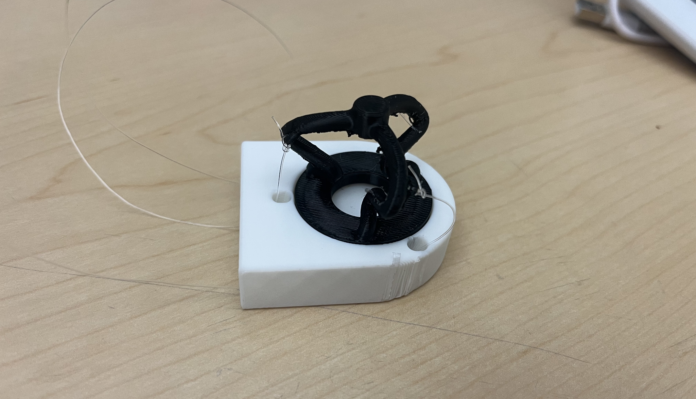
New haptic node design
To model this properly will require a rod simulation with 3D junction handling

Slide 4
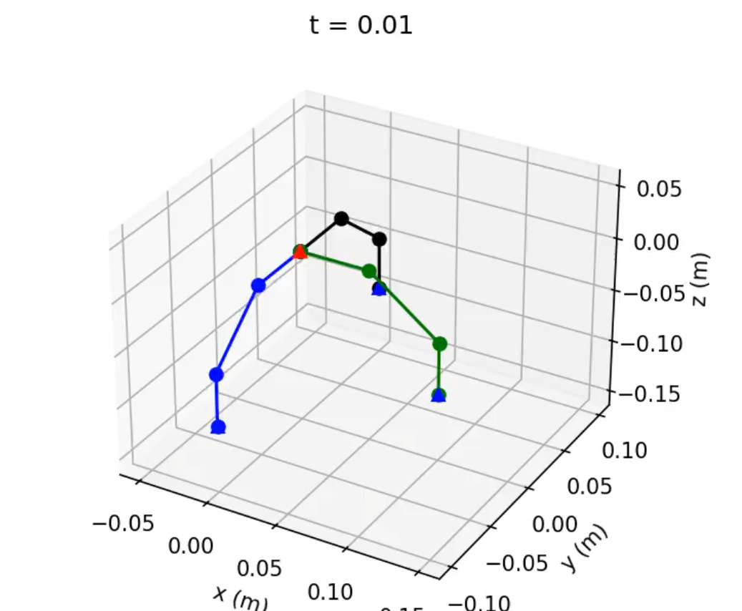
3D Haptic Node Simulation
The goal: allow junction handling, including bending between edges at a junction:
My original goal was to handle bending between every edge, but other papers suggest instead consecutive edges

Slide 5
Junction Handling
Non-bending junction of chains was functional
However, adding bending prevented convergence

Slide 6
The mistakes I made
I tried to flatten the rods into a global dof vector, which made indexing challenging
I wanted to calculate bending between each edge pair at a junction, rather than consecutive edges.
In approaches like dismech, bending calculation is computed in consecutive edges into a junction
When calculating bending for an edge pair at a junction, one must be reversed such that it is
Notes:
A large problem in assembling the 3D network was trying to flatten multiple rods into one DOF vector in order, which allowed me to flatten

Slide 7
Junction Handling Continued
My initial plan was to be able to handle arbitrary rod networks.
A tree search algorithm was my plan to assemble the network.
Could parallel transport down from a single end edge.
Every junction would have 1 edge in, n edges out.
Notes:
My initial overall plan was, once I figured out how handle junctions, to create a tree search, as shown in this arbitrary network here. The goal was to assemble a rod for each, and do junction handling whenever a junction is found.

Slide 8
Next Approach
Going forward, I will likely be using dismech, which handles junction functionality.
Alternatively, I will replicate the dismech edge handling strategy and apply it to my tree search method.

